Slide 1


Navigating Software Engineering: A Comparative Study of Agile, Waterfall, and Beyond
Slides Created by Michael Connell

Slide 2

Where to start?
Exploring the evolution and impact of software engineering process models.
Focus on Waterfall, Agile, Scrum, and XP methodologies.
Transition from rigid, linear processes to dynamic, adaptive approaches.

Slide 3
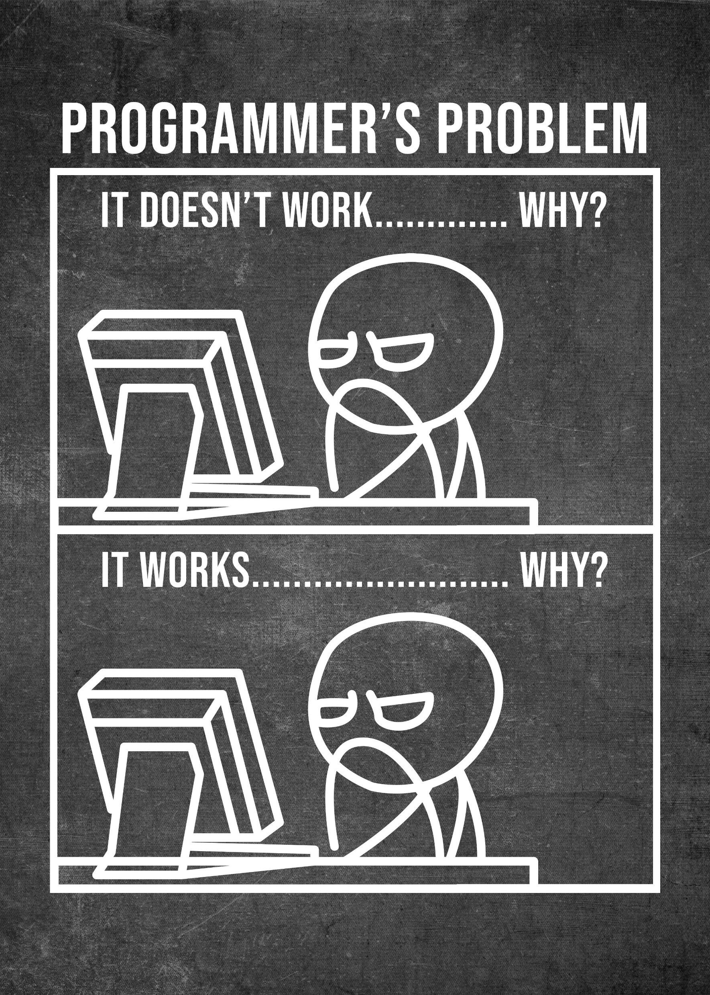
The Role of Software in Computer-Based Systems
Software's transition from functional component to critical driver in technology.
Challenges in developing high-quality software within time and budget constraints.
Introduction to software engineering: processes, methods, tools.
Five framework activities and core principles of software engineering.

Slide 4
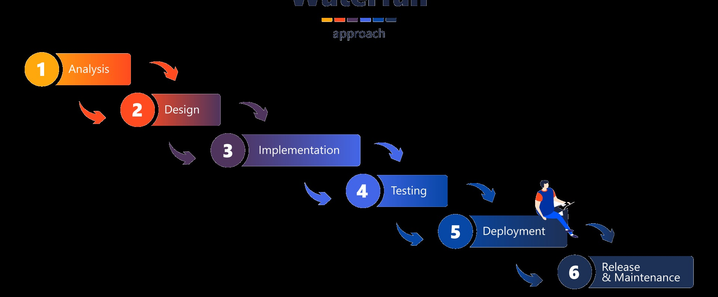
Waterfall Model
Characteristics of the Waterfall model: linear and sequential phases.
Effectiveness in projects with well-defined, stable requirements.
Limitations in dynamic project environments due to rigidity.

Slide 5
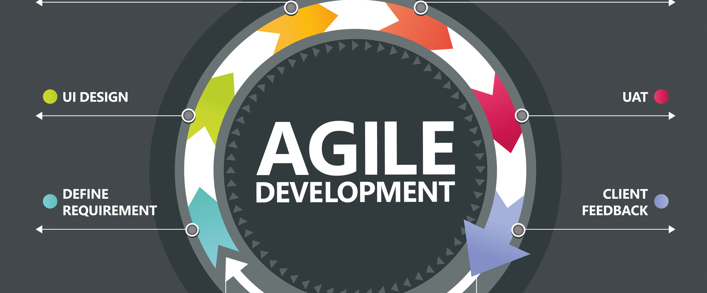
Agile Software Development
Agile as a dynamic response to traditional model limitations.
Emphasis on adaptability, iterative development, and customer collaboration.
Breaking projects into manageable increments for continuous reassessment.

Slide 6

Challenges of Developing High-Quality Software
Navigating the challenges in software development
Technological evolution
Diverse customer needs
Balancing quality with constraints.

Slide 7
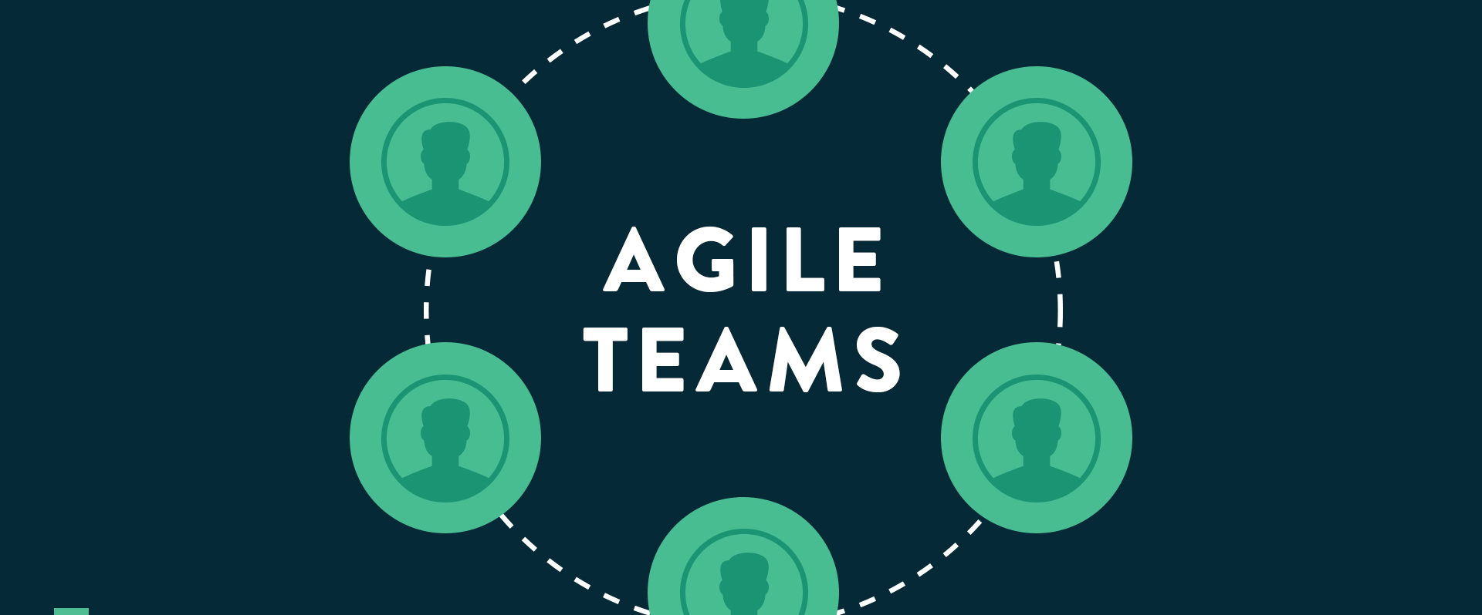
Agile's Response to Software Development Challenges
Agile methodologies' flexibility and adaptability in addressing software development challenges.
Principles of continuous feedback, iterative development, and team collaboration.

Slide 8
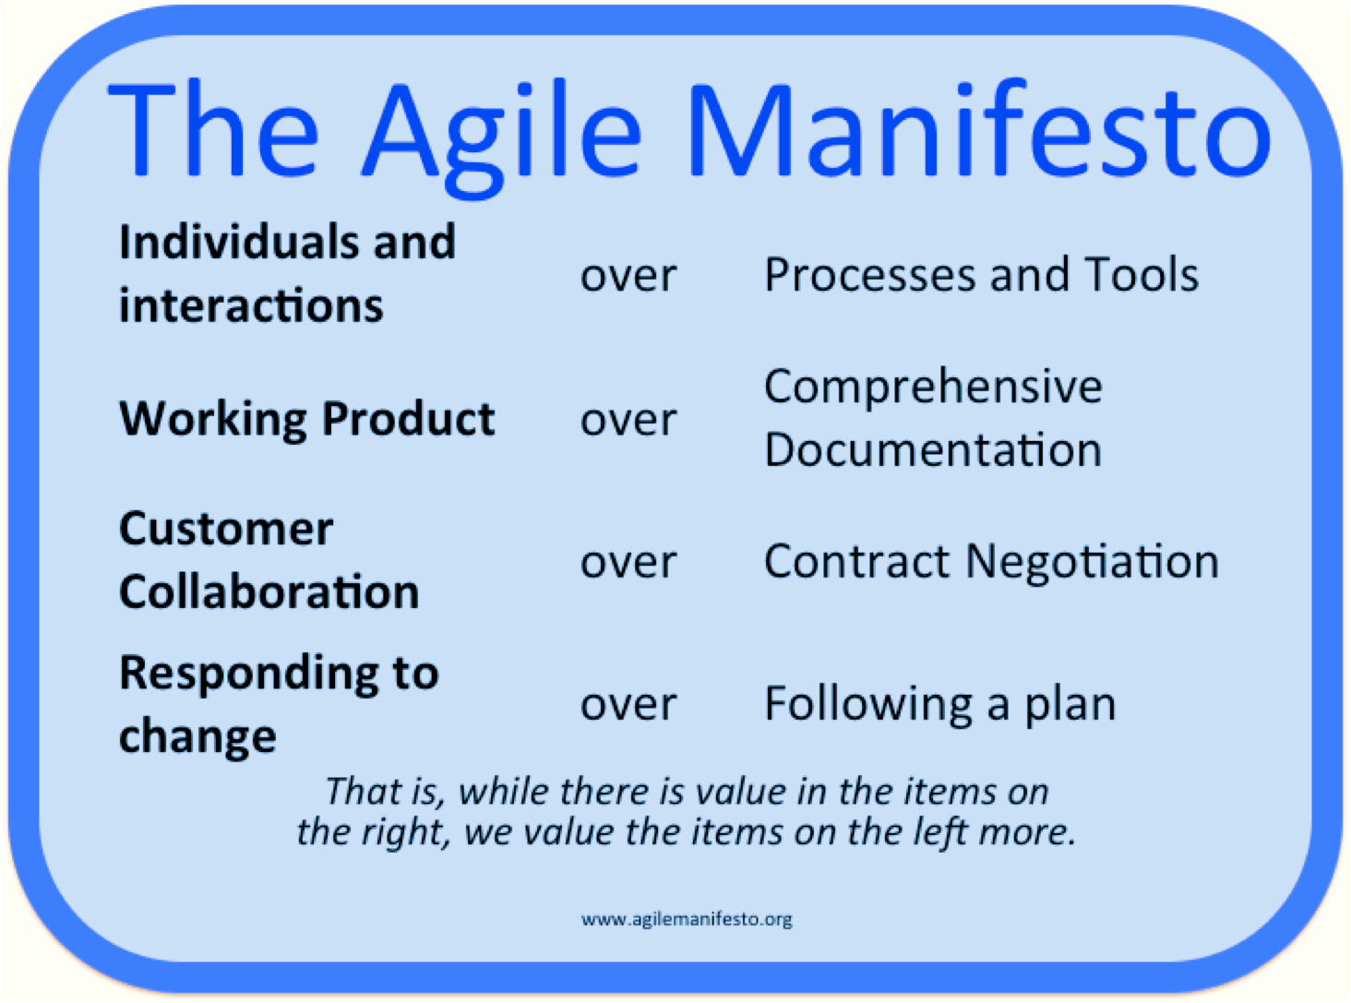
Agile Manifesto and Its Influence
The Agile Manifesto: prioritizing individuals, working software, customer collaboration, and response to change.
Influence on modern software development and various Agile methodologies.

Slide 9
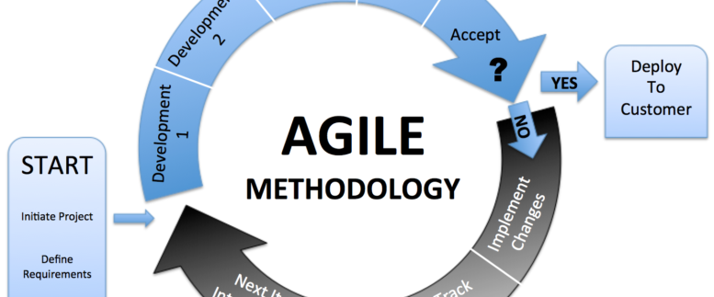
Key Agile Methodologies: Scrum, XP
Overview of Scrum and Extreme Programming (XP) methodologies.
Scrum's framework for complex project management.
XP's focus on technical excellence and responsive development.

Slide 10

Real-World Success Stories
Case studies of Agile implementation in various industries.
Examples from companies like Spotify and Microsoft.
Demonstrating Agile principles in solving complex software development challenges.

Slide 11

Challenges in Adopting Agile
Challenges faced during the transition to Agile methodologies.
Cultural resistance, need for a shift in processes, and redefining roles.

Slide 12

Conclusion
Reflection on the dynamic field of software engineering process models.
Evolution from traditional models like Waterfall to Agile methodologies.
The pursuit of efficient, flexible, and effective software development.
Questions & Feedback

Slide 13
References
Synoptek. (2021, April 30). 10 Software Development Challenges Every Developer Faces. Retrieved November 12, 2023, from https://synoptek.com/insights/it-blogs/10-challenges-every-software-product-developer-faces/
Lucidchart. (n.d.). The Pros and Cons of Waterfall Methodology. Retrieved November 12, 2023, from https://www.lucidchart.com/blog/pros-and-cons-of-waterfall-methodology
Kissflow. (n.d.). 9 Key Benefits of Using the Agile Methodology. Retrieved November 12, 2023, from https://kissflow.com/project/agile/benefits-of-agile/
GeeksforGeeks. (2023, September 20). Challenges of Software Developers. Retrieved November 12, 2023, from https://www.geeksforgeeks.org/challenges-of-software-developers/
Agile Alliance. (n.d.). Agile Manifesto for Software Development. Retrieved November 12, 2023, from https://www.agilealliance.org/agile101/the-agile-manifesto/

